Slide 1

Vim – An Introduction for Visual Studio Developers
CodepaLOUsa
April 25th – 27th, 2013
Michael Eaton
@mjeaton

Slide 2
@mjeaton

Slide 3
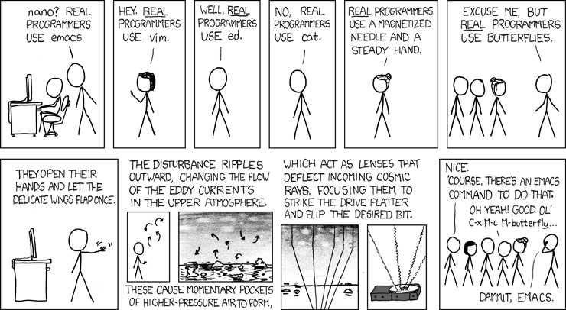

Slide 4
My religion/political party/car/language/music/text editor is better than your religion/political party/car/language/music/text editor!

Slide 5
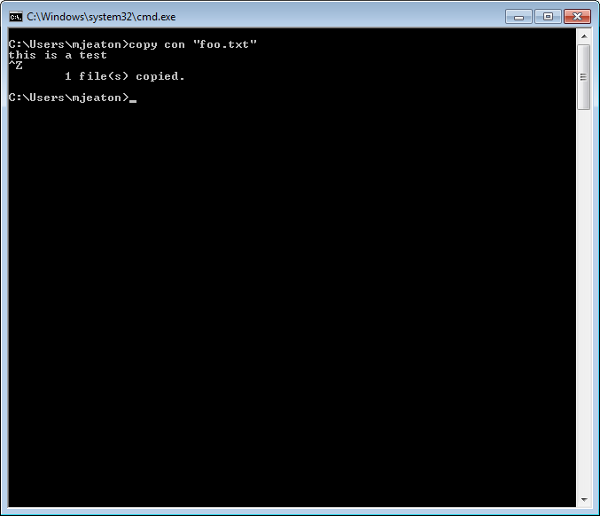

Slide 6
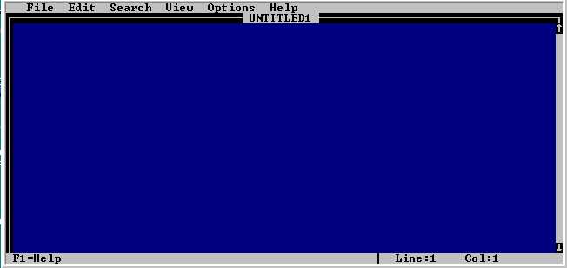

Slide 7
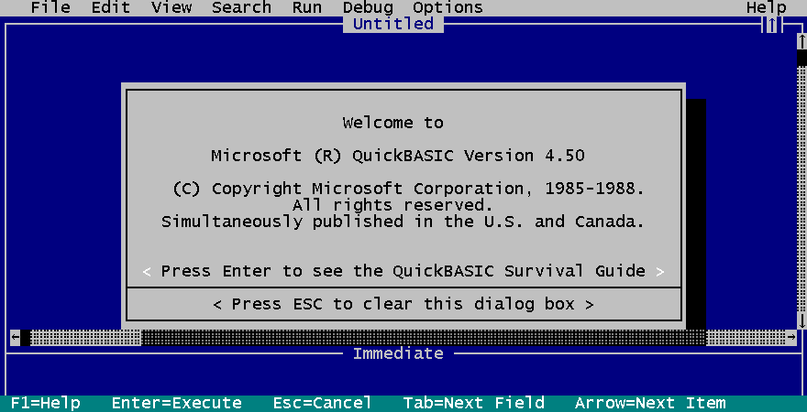

Slide 8
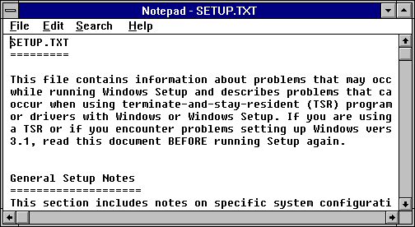

Slide 9
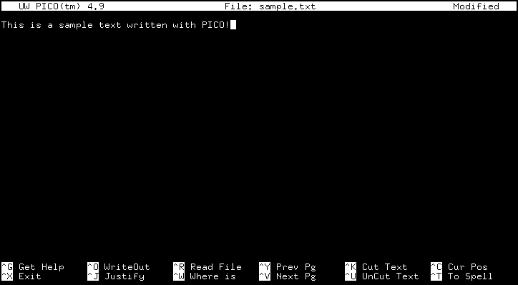

Slide 10
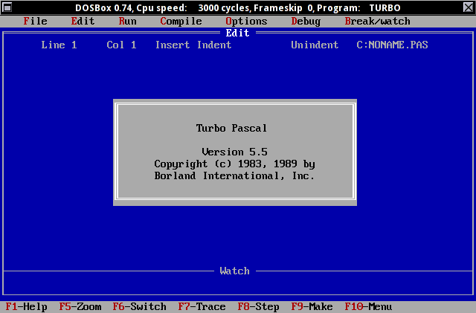

Slide 11
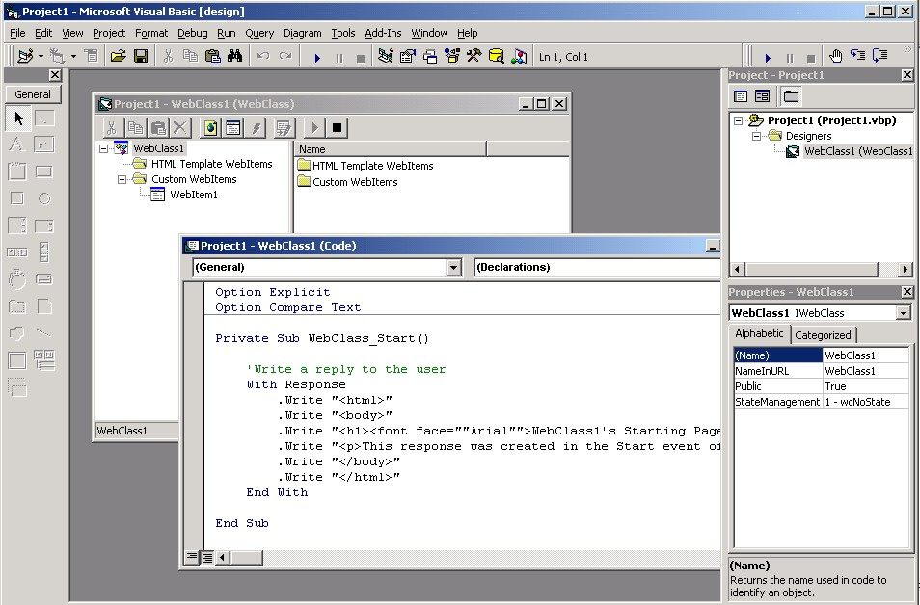

Slide 12
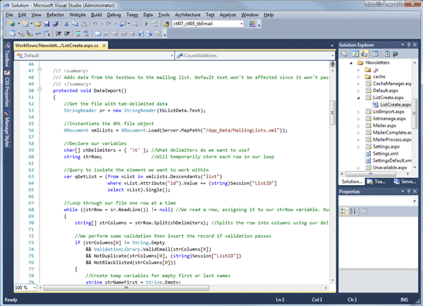

Slide 13
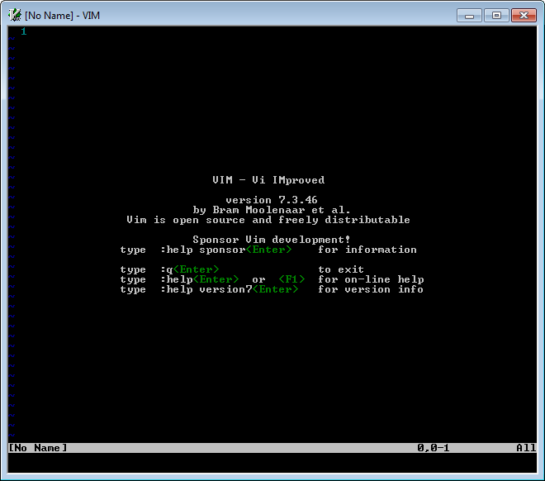

Slide 14
Vim?
Notes:
Why vim?

Slide 15
vim/gvim/vsVim/viEmu

Slide 16

Notes:
Learning Curve

Slide 17


Slide 18


Slide 19
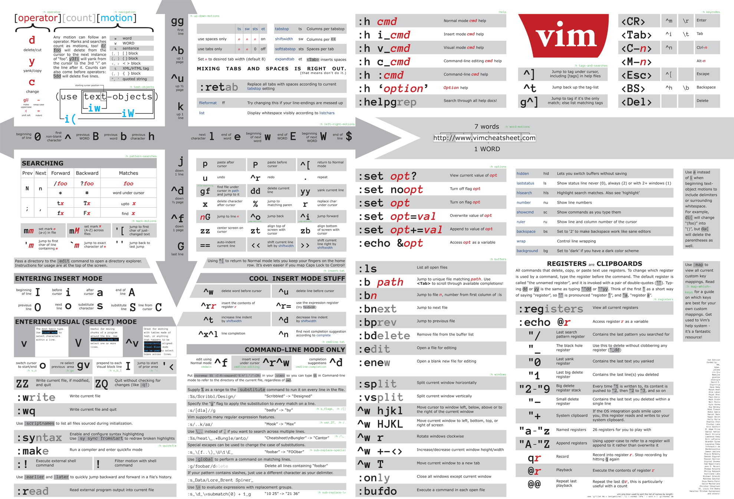

Slide 20
beeping!!

Slide 21
command/normal mode, insert mode, :ex, visual mode

Slide 22
:e

Slide 23
i

Slide 24
<escape>

Slide 25
h,j,k,l

Slide 26
/

Slide 27
d

Slide 28
ci

Slide 29
:%s

Slide 30
u,ctrl-R

Slide 31
:w

Slide 32
ZZ, :q

Slide 33
buffers

Slide 34
:tabnew, :tabe

Slide 35
vimtutor

Slide 36

More info
http://vim-adventures.com/ https://github.com/alanstevens/KickAssVim
http://www.vim.org
http://pragprog.com/book/dnvim/practical-vim

Slide 37
Contact Info
Email: mjeaton@validussolutions.com
Blog: http://mjeaton.net/blog
Twitter: @mjeaton

